Slide 1
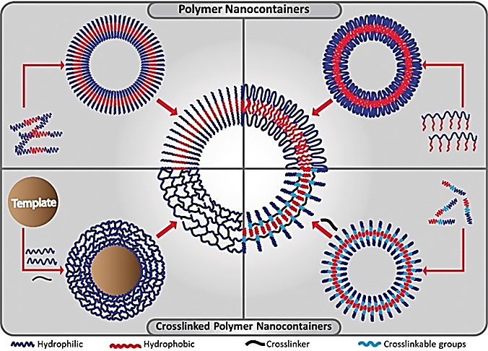
Polymer NanO-containerS
Intracellular Delivery Systems

Slide 2
Introduction
Hollow polymer particles – the so-called “polymer nanocontainers
High stability and tunable properties.
High potential for applications in biotechnology:
a) confined reaction vessels.
b) protective shells for enzymes.
c) ‘traps’ for the selective recovery of biotransformation or polymerase chain reaction products.
Major interest as drug delivery devices in biomedical field.

Slide 3
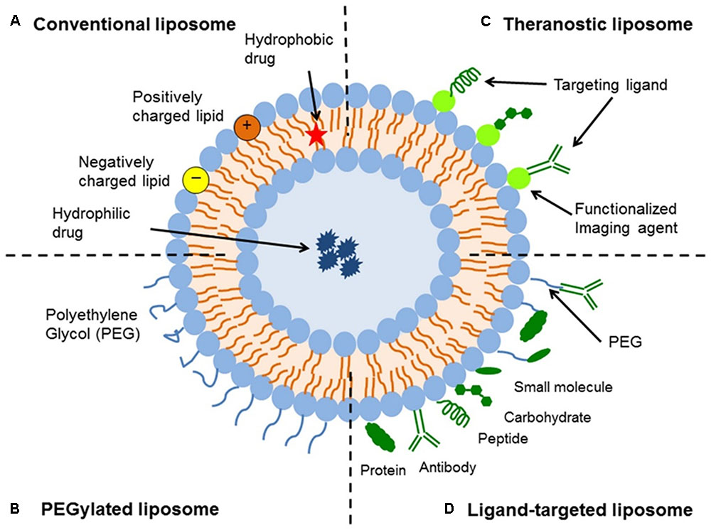
From Liposomes in Biotechnology to Polymer Nanocontainers in Therapy
The pioneering studies on lipid vesicles or liposomes were conducted in the early 1960s.
Vesicles are spherically closed lipid bilayers that result from the naturally occurring self-assembly process of amphiphilic molecules.
Liposomes that served mainly as model systems to study biological membranes can be used as transport vehicles for drugs.
In topology of two-dimensional surfaces floating in a three-dimensional continuum.

Slide 4
From Liposomes in Biotechnology to Polymer Nanocontainers in Therapy
As model systems in biophysics (properties of cell membranes and channels).
In chemistry (catalysis, energy conversion and photosynthesis).
Colloid science (stability and thermodynamics of finite systems).
Biochemistry (function of membrane proteins).
And in biology (excretion, cell function, trafficking and signaling, gene delivery and function).

Slide 5
From Liposomes in Biotechnology to Polymer Nanocontainers in Therapy
Controlled delivery devices for drugs (example antifungals, anticancer agents, vaccines),
Nonviral gene delivery vectors,
Cosmetic formulations(skin-care products, shampoo),
Diagnostic tools.
‘Stealth’ liposomes- improvements in their formulation, mainly to increase their stability and interaction characteristics.

Slide 6
From Liposomes in Biotechnology to Polymer Nanocontainers in Therapy
Biotechnological applications of liposomes are based on the compartmentalization:
For example vesicles from 2,4-tricosadiynoic acid (TCDA) as the lipid matrix and dioctadecyl glyceryl ether−β-glycoside as a receptor to detect Escherichia coli.
Served as effective colorimetric biosensors.
due to the diacetylene groups, appear blue.
Binding to bacteria mechanical stress inside the vesicular membranes change in effective conjugation length vesicle dispersion turns red.

Slide 7
From Liposomes in Biotechnology to Polymer Nanocontainers in Therapy
Liposome: DNA amplification by PCR and minimal cell bioreactors to express proteins (Oberholzer et al).
Concept of “Artificial cell”
DNA replication or ribosomal synthesis of polypeptides can be carried out inside the compartment offered by the aqueous pool of the liposomes.
Drawbacks:
inherent colloidal and biological instability
very short lifetimes.

Slide 8
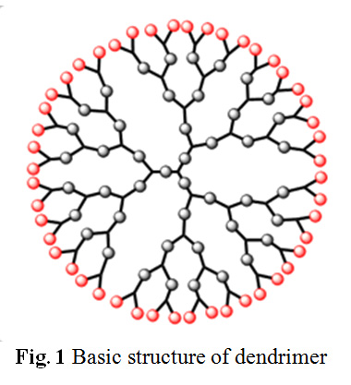
Dendrimers
Dendrimers are highly branched polymers with radial symmetry and uniform size, which adopt a globular shape in solution.
Dendritic macromolecules or starburst dendrimers consist of three different structural or topological units that result from an iterative reaction sequence:
a central core from which the repetitive branching units extend/emanate radially to finish in the outer layer of end-groups.

Slide 9
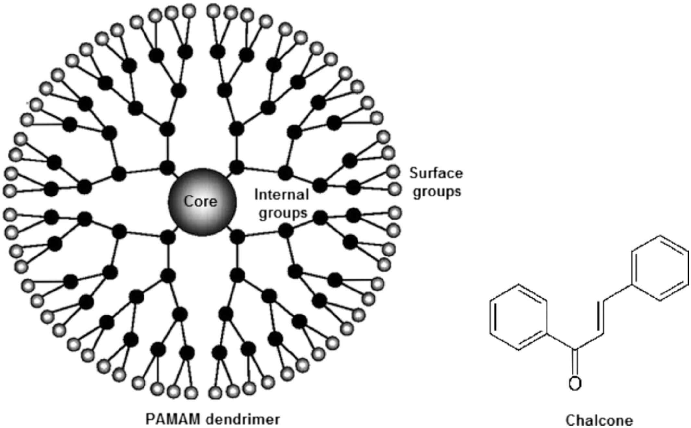
Dendrimers
With each generation- the density is increased due to the geometric growth at each branching point.
Molecules have been encapsulated during the synthesis of the dendrimer and were retained within the central part of the macromolecules.
The release of the molecules could be facilitated by an appropriate modification of the external groups of the dendrimer.
Synthetic design affords dendrimers with tailored structures
Polyamidoamine (PAMAM) dendrimers are most common class of dendrimers suitable for various applications.

Slide 10
Dendrimers
The repeating units in the interior determine the solubilization properties towards guest molecules.
The functional terminal groups influence the solubility of the dendrimer itself in a given solvent.
Amphiphilic dendrimers - in which the interior is comprised of hydrophobic moieties and the external groups consist of hydrophilic units.
Also, regarded as “unimolecular micelles”.
Dendrimers can be used to prepare real hollow structures by selectively crosslinking their outer shell and degrading the original core region.

